Slide 1
Lesson 1: Solar System Animation -
Solar System Animation
Mission to Mars Coding Unit •
Year 5 • DelightEx

Slide 2
LEARNING OBJECTIVES
Make planets move in circles that never stop
Make lots of planets move at the same time
Make close planets move faster than far planets
Key Concepts: Paths, Forever Loops, Parallel Processing

Slide 3
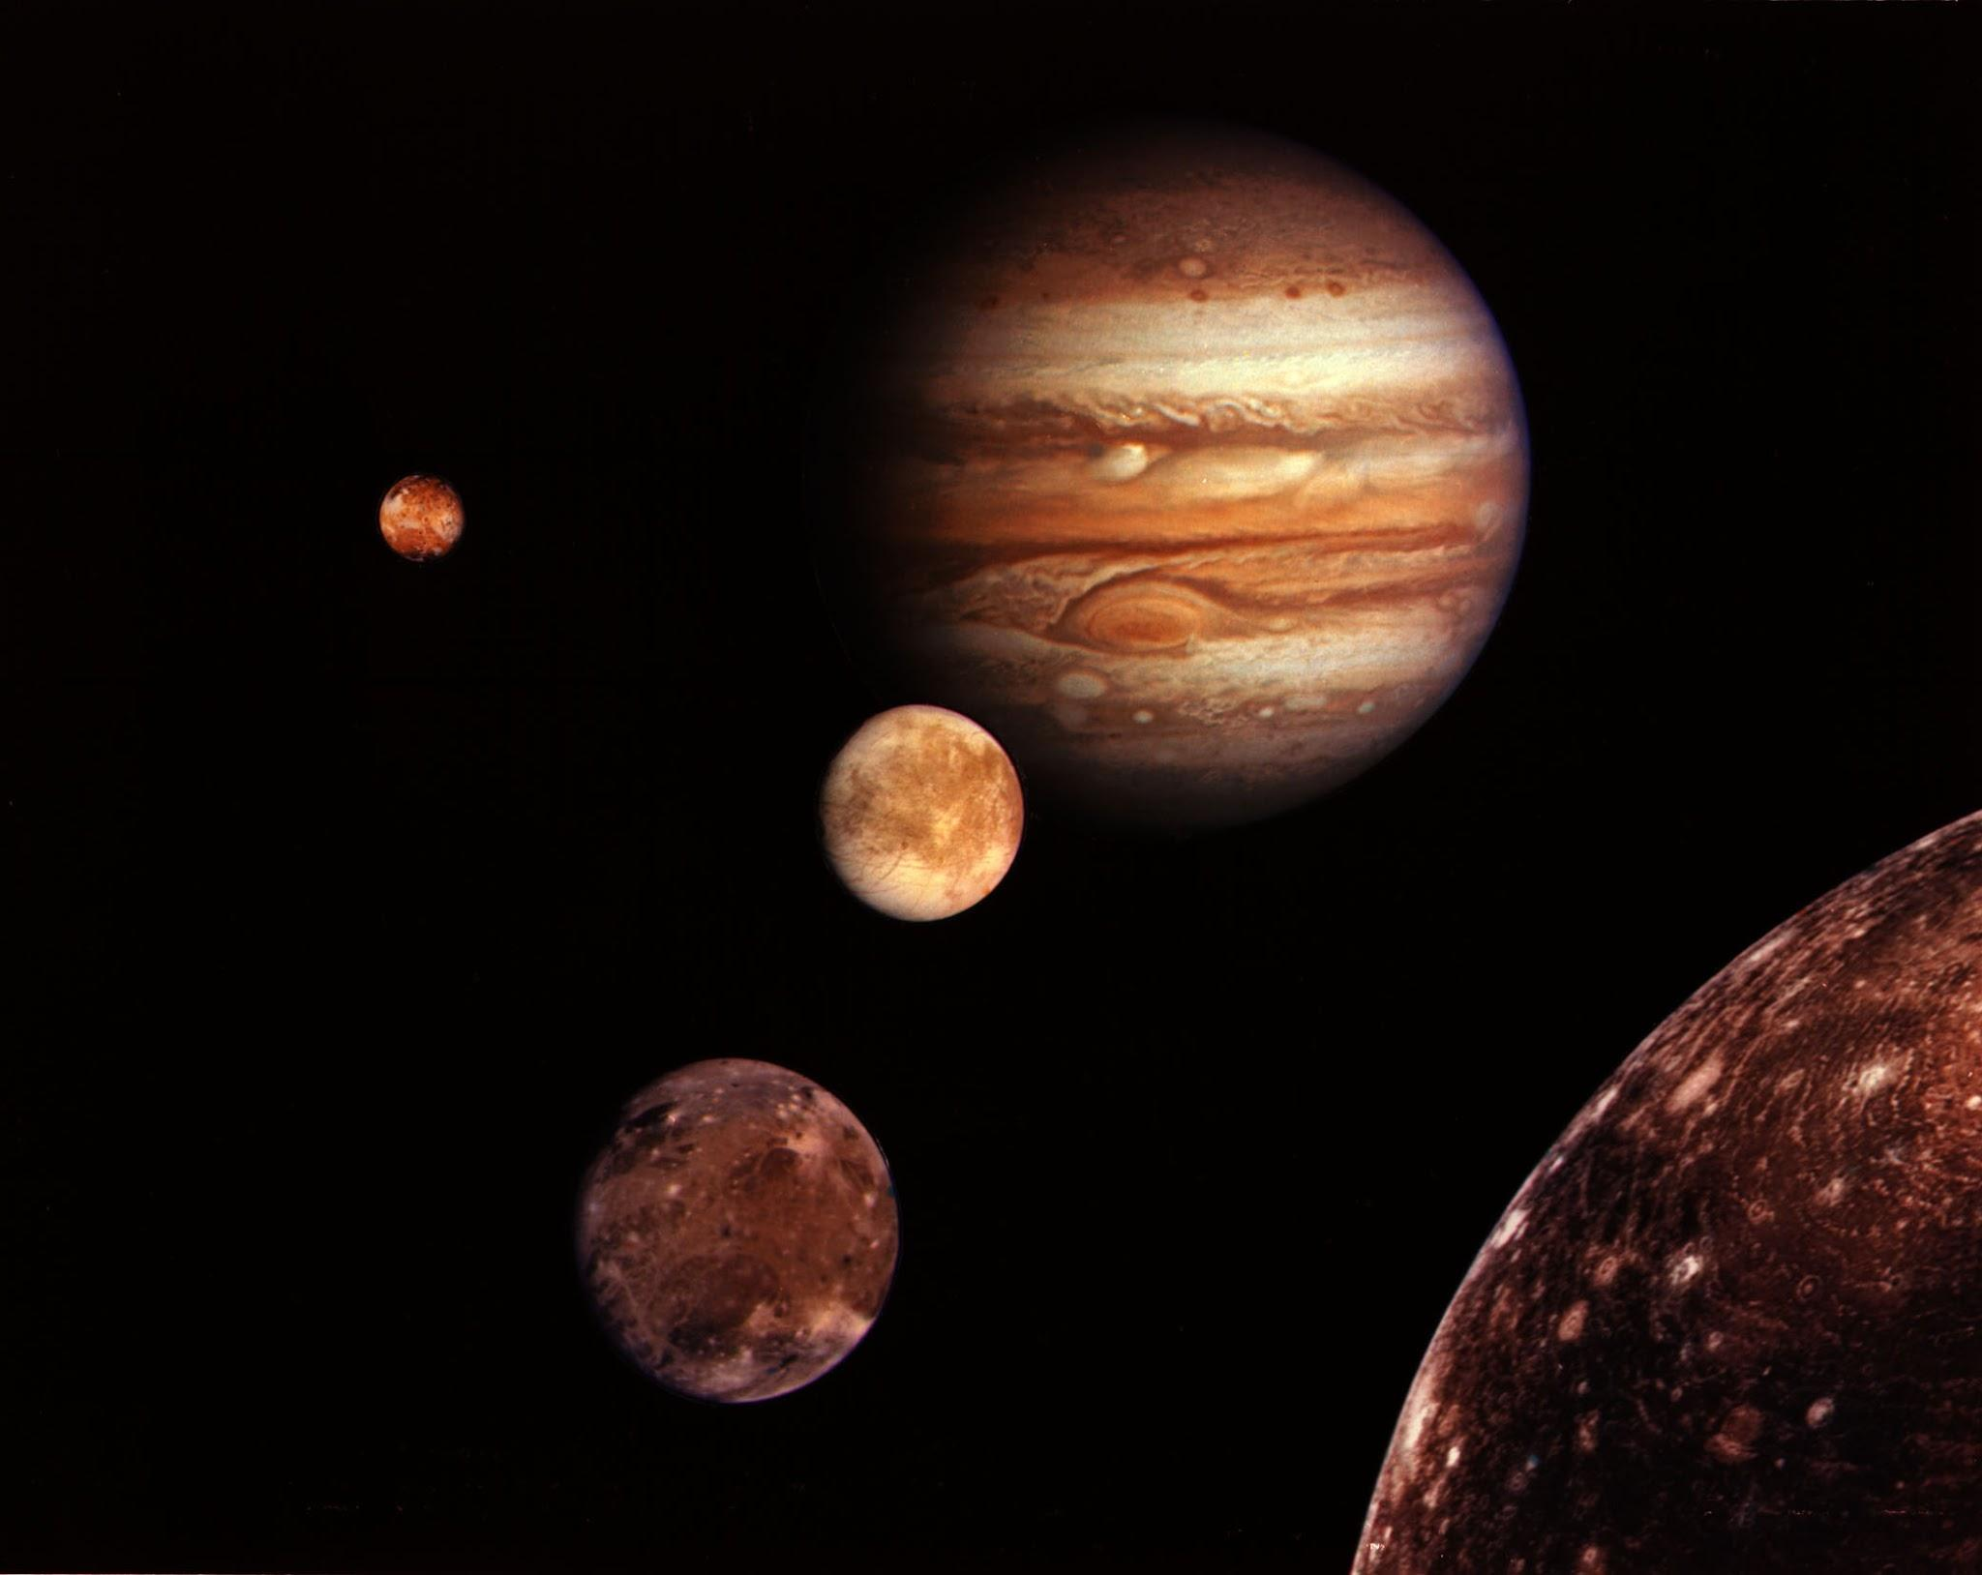
🚂 Paths = Train tracks or race car circuits Objects follow predetermined routes
🎡 Forever loops = A ferris wheel that never stops spinning Continuous, repeating motion
🎺 Parallel processing = A marching band Everyone plays their part at the same time
`

Slide 4
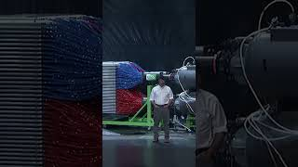
Parallel Process in real life! CPU v GPU

Slide 5
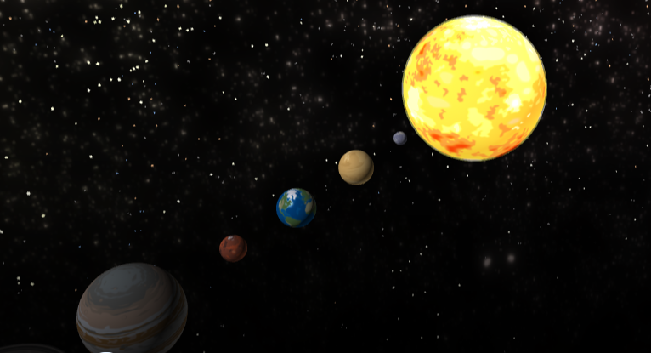
WAGOLL
Notes:
https://edu.delightex.com/XUX-KFG
Student WAGGOL

Slide 6
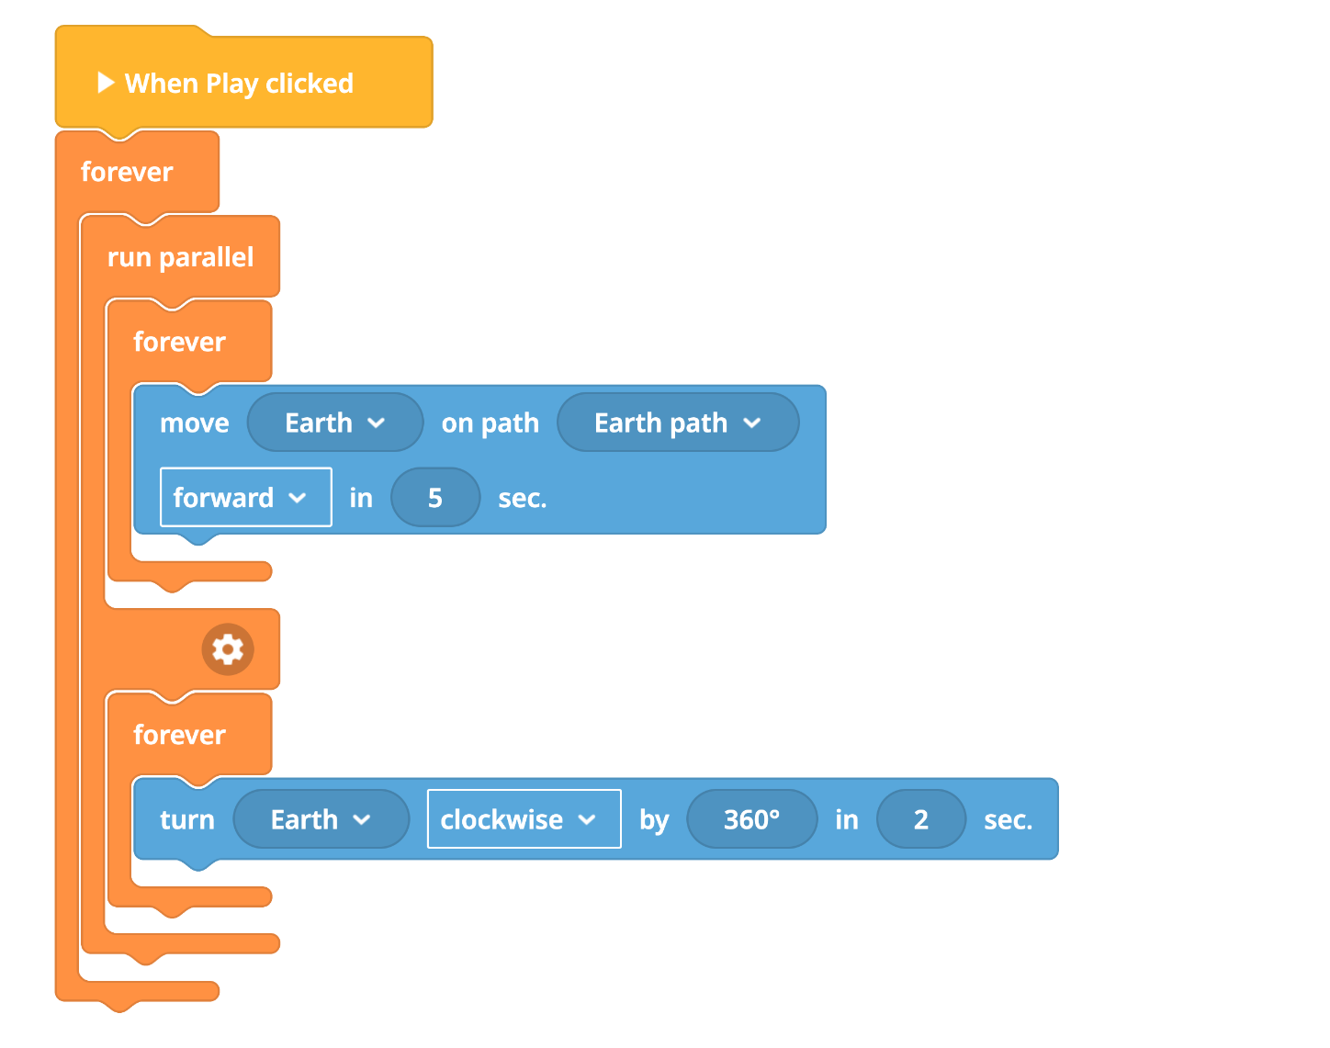
CODE STRUCTURE
Code Structure
Building Your Animation:
Create circular paths for each object
Set different durations (closer planets = shorter times)
Use run parallel so all objects move at once

Slide 7
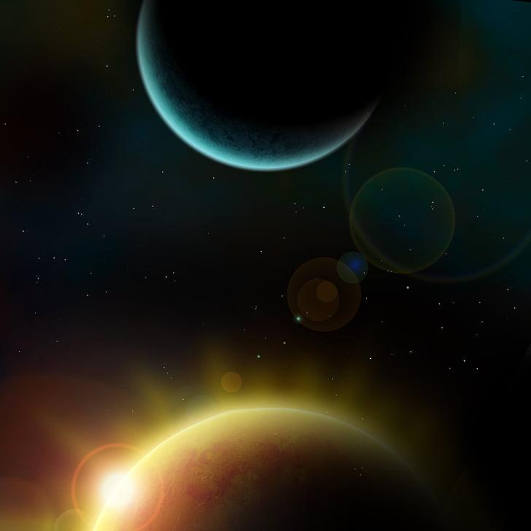
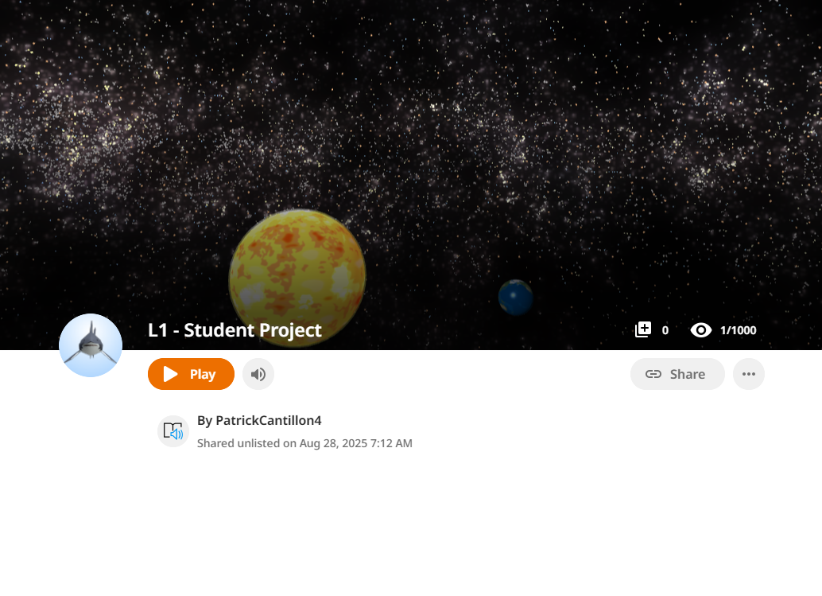
Template

Slide 8
- MINI PLENARY
Check Your Progress
Content: Discussion with your partner:
Do your planets move continuously without stopping?
Are closer planets moving faster than distant ones?
What happens if you change the duration numbers?
Next: Share your discoveries with the class!

Slide 9
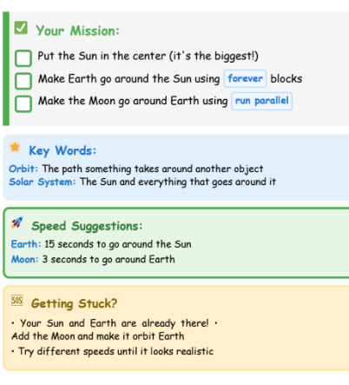
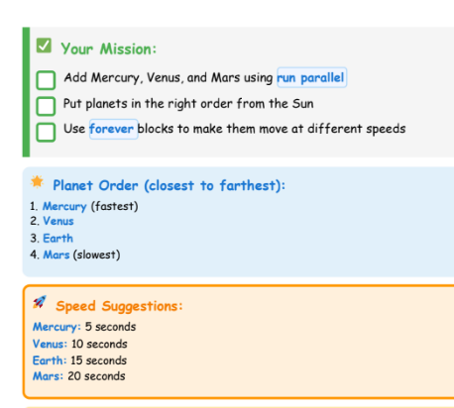
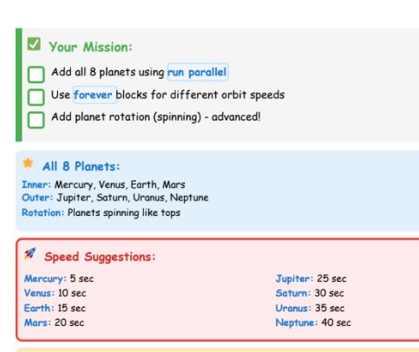
🌟 Mild:
⭐⭐ Hot:
⭐⭐⭐ Spicy
Notes:
Difficulty with moving the moon - have to group earth and moon as they move around path can cause confusion Get planets moving in parallel first around the sun

Slide 10
PLENARY
Today's Achievements
: 🎉 What We Achieved:
Created smooth orbital animations
Used parallel processing for multiple objects
Applied realistic timing relationships

